Slide 1
Analyzing astrological & demographic influence on
Divorce Rates…
Team 7
Project 3

Slide 2




Team 7
Erik
Pedro
Karen
Brian

Slide 3

Our Database: Divorces in Veracruz
3505 rows and the clean up
We chose to analyze the zodiac signs of the data to answer some of the following questions:
Which zodiac signs have the higher income? Is it a determinant factor?
Which combination of zodiac signs are the most compatible?
And other general demographic questions:
At what age the divorces rate is the most common?
Does the scholarization level have any impact?
Where do most of these divorces happen?

Slide 4
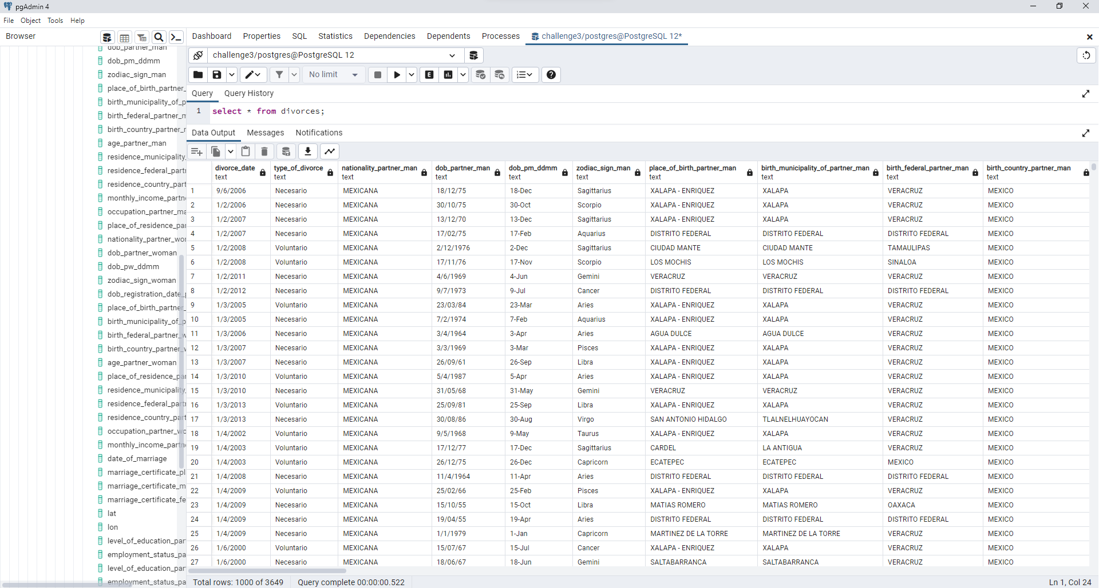
SQL
We used python to populate our SQL database with our .csv file:

Slide 5
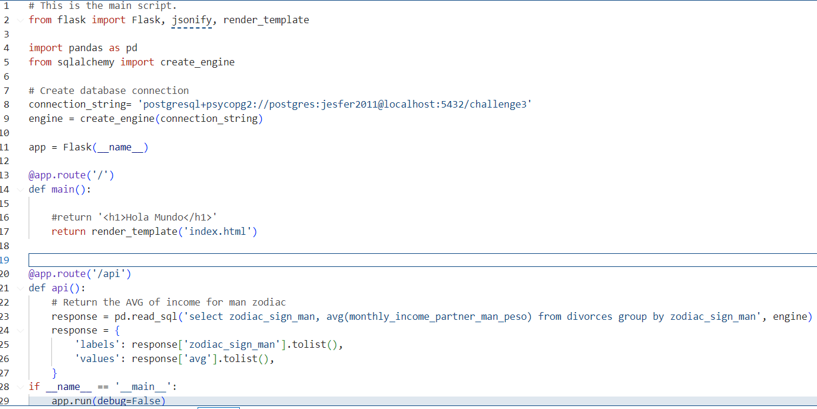
Python Flask-powered API & SQL

Slide 6
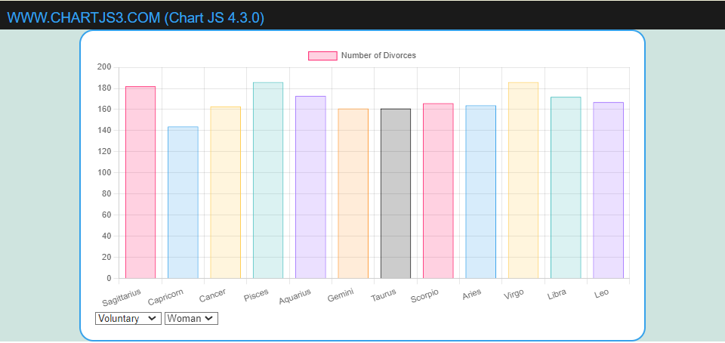
User level interaction: Dropdown using Chart.js
Number of divorces by zodiac sign & gender
The dropdown lets you toggle between gender & divorce type

Slide 7
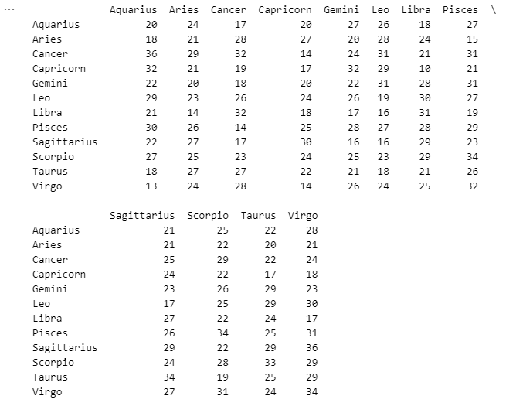
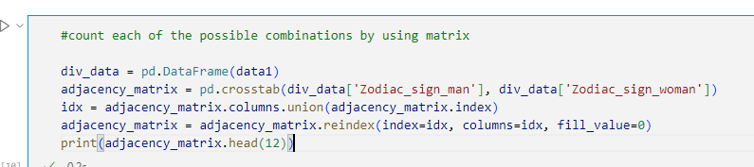
Zodiac Sign compatibility
Good match or Bad match?

Slide 8
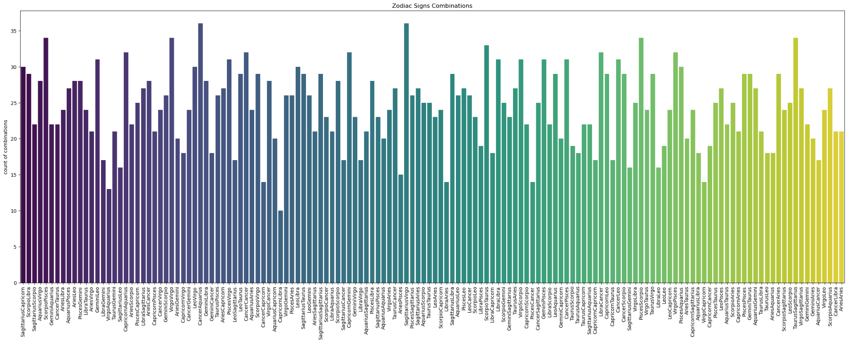
Zodiac Sign compatibility
Most compatible pair: Capricorn & Leo (10)
Least compatible pair: Cancer and Capricorn (36)

Slide 9
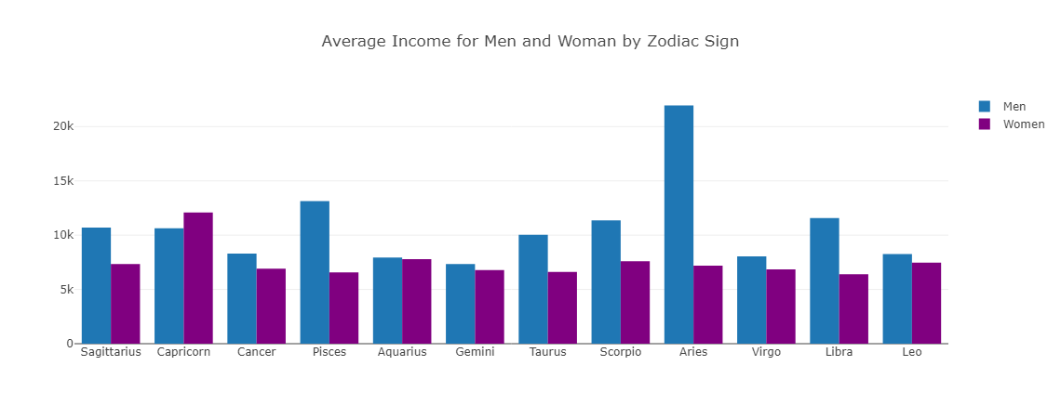
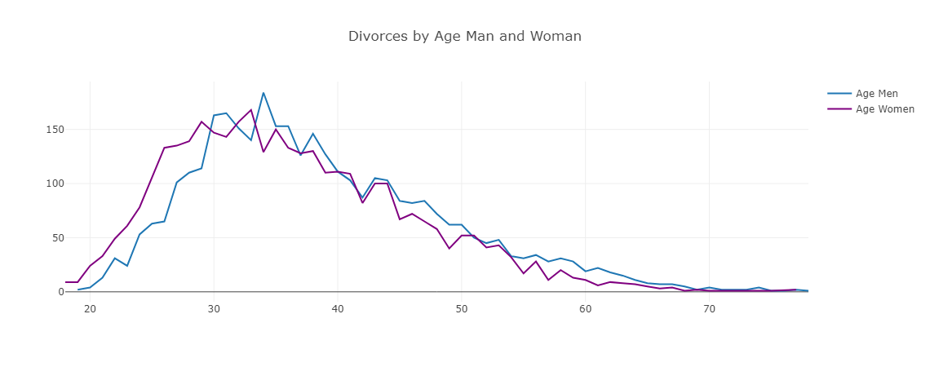
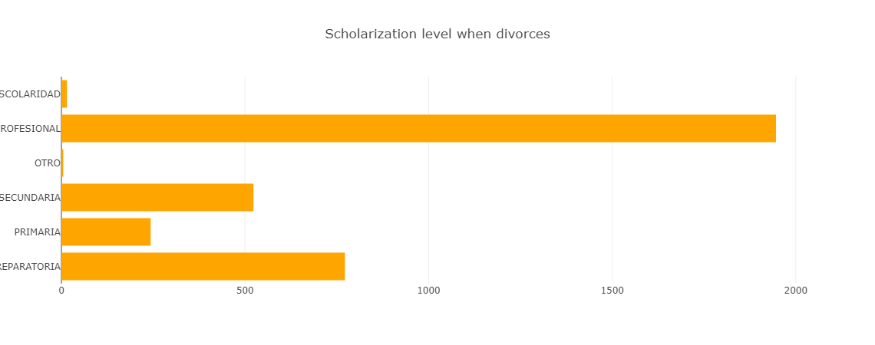
Visualizations obtained with HTML/CSS, JavaScript & Plotly

Slide 10
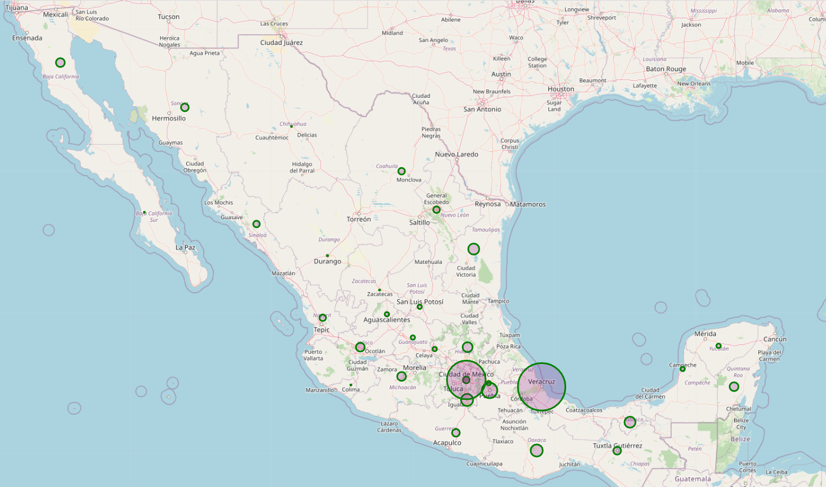
Geographical Visualization using Leaflet
Quantity of divorces by state

Slide 11
Conclusion
This project successfully utilized a combination of HTML, CSS, Plotly, Leaflet, and API integration to present a compelling data story on divorce rates.
The use of HTML and CSS allowed us to design a user-friendly interface. Plotly proved to be an invaluable tool for visualizing demographics, such as age trends, scholarization patterns and income across zodiac signs.
Leaflet, enabled us to incorporate geographic information by exploring the location of divorce rates.

Slide 12
Thanks for your attention!
Questions?

